Slide 1
Writing Your Own Classes

Slide 2

Objectives
At the end of the lecture, you will be able to :
Describe what is User-defined Class
Discuss the concept of Encapsulation
Implement a Class
Access data and methods of an object
Notes:
Welcome to the lecture. In this lecture you will learn to write your own class. At the end of this lecture, you will be able to describe what is User-defined Class, Discuss the concept of Encapsulation,
Implement a Class and Access data and methods of an object

Slide 3
Introduction to User-defined Classes
Pre-defined Class
already implemented and made available in the C# Libraries (C# API).
e.g. List, Math, Random, DateTime
you only need to make use of them via method calls
User-defined Class
implemented by the user himself/herself to be used in his/her own application
e.g. Student, CashCard, SavingsAccount, Customer
Notes:
Pre-defined classes are classes that are already implemented by other people and made available for any other programmers to use in the C# libraries. You have already used some of them in our previous lessons, e.g. Console class for input and output, List class for collection, or DateTime class for working with date and time.
However, not all classes that you want to use are pre-defined for you. Thus you need to learn how to define your own class. Classes that programmer define for his own application is known as user-defined class. You may recall that we have the SalesEmployee class and FP1Student class in the previous lesson. These are examples of user-defined classes.

Slide 4
Encapsulation
hides irrelevant data from user
A class may contain much information that is not useful for an outside class
So classes use encapsulation to hide its members (data and methods) that are not relevant for an outside class
Access Specifiers | Visible to objects of other classes
private | No
public | Yes
Note: There are also protected, internal and protected internal access specifiers (See Appendix)
Notes:
Encapsulation is a principle of wrapping data and method together as a single unit. It is one of the four OOP concepts. The other three are Inheritance, Polymorphism, and Abstraction which we will learn in the next few lessons.
Object oriented programming principles say that, the internal workings of a class should be hidden from the outside world. If you expose a field you're in essence exposing the internal implementation of the class. Therefore we wrap fields with Properties to give us the ability to change the implementation without breaking code depending on us.
A class may contain much information that is not useful for an outside class, these information should be hidden from user. Classes use encapsulation to hide its data and methods that are not relevant for an outside class.
Encapsulation is implemented by using access specifiers. Members that are defined with private access specifier will not be visible to objects of other classes but if it is defined with public access specifier, they will be visible to other classes. You recall in our previous lesson, fields are defined with private accessibility whereas properties and methods are defined with public accessibility. This is because we want other classes to use the properties and methods. Of course you may define methods with private accessibility if these methods are only to be used within the same class.
There are also protected, internal and protected internal access specifiers as shown in the appendix on the last slide, just to complete the picture of access specifiers.

Slide 5
Encapsulation – Access Specifier
SavingsAccount
-accountNo:string -accountName:string -balance:double | Not accessible by objects of other classes
+SavingsAccount() +SavingsAccount(string,string,double) +Deposit(double) +Withdraw(double):bool +ToString():string | Accessible by objects of other classes
Notes:
As shown in the class element diagram for SavingsAccount class, the accessibility for the attributes accountNo, accountName and balance are private, they will not be accessible by objects of other classes. Whereas the accessibility for the constructors and methods are public, they are accessible by objects of other classes.

Slide 6
Implementing a User-defined Class
A User-defined Class is implemented by :
implementing the attributes using instance variables
implementing the behaviour using methods
Note
Implementing a Class is sometimes referred to as writing the Class Definition
Attributes and behaviors of a class are known as members of the class
Notes:
Recall that there are 3 parts in the class diagram. The first part indicates the class name, second part shows the attributes and the last part shows the behaviours. To implement a user-defined class, instance variables are used for the attributes and methods are used for the behavior.

Slide 7
Implementing a User-defined Class
Implementing the Attributes
Fields and Properties
Implementing the Behaviour
Constructors
Other Methods
ToString() Method
Class Name
Attributes
Behaviour
Notes:
To implement the attributes, we define the fields and properties.
To implement the behavior, we define the constructors and methods. We normally define the toString() method in the class. We will discuss more about this method later.

Slide 8
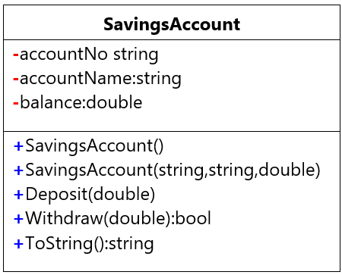
Implementing the Attributes
Attributes are implemented using instance variables
Variables are declared private
to hide/protect variables from illegal access by other objects
-> variables can only be accessed by other objects via public
methods provided
e.g.
private string accountNo;
private string accountName;
private double balance;
:
Notes:
Field is a class level variable that can holds a value. Generally field members should have private access modifier and used with a property. A property can be defined using getters and setters which we will learn in the next slide.
The class element diagram shows the SavingsAccount class that has 3 attributes, accountNo, accountName and balance. Hence we declare the 3 instance variables with the type as shown in the class element diagram, and use the private access modifier. Thus the 3 statements private string accountNo, private string accountName and private double balance.

Slide 9
Properties
Properties provide a flexible mechanism
for retrieving (get) the private value of an attribute
for storing (set) the private value of an attribute
1 property for each attribute
// private attributes
private string accountNo;
// public properties
public string AccountNo
{
get { return accountNo; }
set { accountNo = value; }
}
Properties can be used as if they are public data members
Properties are actually special (set/get) methods called accessors.
value keyword is used to define the value assigned by the set accessor
Notes:
For each field, we define the property which is used to access the variables. There will be a get method to retrieve the value of the field and a set method to set the value of the field.
E.g. for the field accountNo, we have the statement private string accountNo to declare the instance variable. Together with it, we define the get and set method in the property for AccountNo. In this example, accountNo (spelt with lowercase a) is a private field which cannot be accessed directly. It will only be accessed via AccountNo (spelt with uppercase A). Thus, AccountNo encapsulates accountNo. The get method here simply retrieves the value of accountNo and the set method simply sets the accountNo to the value pass in without any additional logic. The word value used in the set method is the keyword that defines the value assigned by the set method. Of course you can also define the get and set method with additional logic if it is needed. You may explore this yourself when you are more familiar.

Slide 10
Implementing the Properties
// private attributes
private string accountNo;
private string accountName;
private double balance;
// public properties
public string AccountNo
{
get { return accountNo; }
set { accountNo = value; }
}
public string AccountName
{
get { return accountName; }
set { accountName = value; }
}
public double Balance
{
get { return balance; }
set { balance = value; }
}
1 Property for each attribute
Both have the same name
Attribute name starts with lowercase
Property name starts with Uppercase
:
Notes:
This slide shows the complete implementation of the attribute for the SavingsAccount class. As there are 3 attributes, there will be 3 properties. Please note that attribute names start with lowercase letter while property names start with uppercase letter.

Slide 11
Auto-implemented Properties or Simplified Version
// private attributes
private string accountNo;
private string accountName;
private double balance;
// public properties
public string AccountNo
{
get { return accountNo; }
set { accountNo = value; }
}
public string AccountName
{
get { return accountName; }
set { accountName = value; }
}
public double Balance
{
get { return balance; }
set { balance = value; }
}
// public properties
public string AccountNo { get; set; }
public string AccountName { get; set; }
public double Balance { get; set; }
Notes:
From C# 3.0 onwards, property declaration has been made easy if you don't want to apply some logic in get or set. Instead of defining the full property, you can use the simplified version as shown in the example here. The code in left hand side can be simplied to the code in the right hand side.
Notice that there is no private backing field in the simplified version. The backing field will be created automatically by the compiler. You can work with an automated property as you would with a normal property of the class. Automated-implemented property is just for easy declaration of the property when no additional logic is required in the property accessors.

Slide 12
Implementing the Behaviour
3 types of methods in a user-defined Class:
Constructors
for creating objects of the Class
Other methods
for performing some specific task (e.g. deposit money)
ToString() method
for returning the information of an object if possible
Notes:
There are 3 types of methods in a user-defined class.
Firstly, constructor. A constructor is to be used for creating objects of the class.
Next there are other methods for performing some specific task such as to deposit money in SavingsAccount class.
All classes usually contains a ToString method which returns the information of an object.
We will look at the detail of each of these methods in the next few slides.

Slide 13
Implementing the Constructors
Special method of a class that is executed whenever an object is created from the class
Must have the same name as the class itself
Constructors have NO return type - not even void
No-argument constructor (default)
Constructor with no parameters
Parameterized constructor
Constructor with parameters
A constructor is invoked using the new operator.
Syntax:
<access modifier> ClassName( ) { … }
Notes:
A class can have parameterized or no-argument constructors. Constructor with parameter is known as parameterized constructor. On the other hand, constructor without parameter is known as no-argument constructor. A no-argument constructor is also known as default constructor. If a class does not contain any constructor, a default constructor is automatically added so that objects can be created. The constructor will be called when you create an instance of a class. Constructors must have the same name as the class itself and it does not have any return type. General syntax to define a constructor is shown here. We will look at the example on the next slide.

Slide 14
Implementing the Constructors
// default constructor – does not have parameters
public SavingsAccount() { }
// parameterized constructor – with parameters
public SavingsAccount(string no, string name, double bal)
{
AccountNo = no;
AccountName = name;
Balance = bal;
}
:
e.g. To create a SavingsAccount object, acc1:
SavingsAccount acc1 = new SavingsAccount("111", "John", 200.0);
Note: The type and order of arguments in method call must MATCH parameters of constructor
Notes:
The class element diagram shows that the SavingsAccount class has two constructor, one without any parameter, the other one with 3 parameters, the first two are string type and the last one is a double type. These 3 parameters are to be used to set the values of the 3 attributes in the same order shown in the diagram.
To define the default constructor, it will simply be public SavingsAccount followed by a pair of empty parenthesis since there’s no arguments to be given, and a pair of braces without any statement inside. When this constructor is executed, it will set the attributes to the default values, that is, 0 for numeric value and null for string value.
To define the parameterised constructor, we enclose the parameters in the parenthesis and assigns the values of the parameters to the attributes in the body of the constructor.
You may create a SavingsAccount object in another class by using the new keyword which invokes the constructor. As you have defined these two constructors, you may create a SavingsAccount object without parameter simply by calling new SAvingsAccount followed by a pair of empty parentheses or new SavingsAccount and specify the values to be passed in in the parentheses. Do note that the type and order of argument must match with the parameters of the constructor.

Slide 15
Implementing other Methods
public void Deposit(double amount)
{
Balance = Balance + amount;
}
public bool Withdraw(double amount)
{
if (amount <= Balance)
{
Balance = Balance - amount;
return true;
}
else
return false;
}
:
Notes:
Writing methods in class is similar to writing any other methods that you learnt in the first week except that the keyword static is not there. This is because they are instance methods to be called with the instance whereas the methods that we learnt in week 1 are static methods to be called directly without any instances.
For example, The method Deposit takes a double value as the parameter that indicates the amount to deposit to the account. It updates the balance with the amount which is the attribute hence it doesn’t need to return any value. To define this method in the class, the method heading will be public void Deposit with the parameter amount declared as double. The method body increases Balance by the value in amount.
Another example, the method Withdraw that takes a double value as the parameter indicating the amount to withdraw from the account. There may be cases that there is insufficient balance for the withdrawal to take place, thus a value of type bool will be returned back to indicate whether withdrawal is successful. The other class that calls this method may make use of the value returned for some follow up action. As you can see here, the method body is a bit long because an if-else statement is used for the checking. The value in amount is subtracted from balance only if it is less than or equal to balance.

Slide 16
Calling Methods of an Object
Use the dot notation to call your method:
You are able to access the methods because the methods have been declared public
public methods can be accessed by all classes
private data can be accessed only within the class itself
to protect variables from illegal access by other objects
hence can only be modified by other objects via public methods provided
object_Name.Method_Name( )
acc1.Withdraw(50);
Notes:
Once the instance methods are defined, you may use the dot notation to call the method from another class. You are able to access the methods because they are declared with the public access modifier.
For example, if you have created the SavingsAccount object acc1 in Program class, to withdraw $50 from acc1, the statement acc1.Withdraw(50) is used. Some of you may ask what happens to the value returned. In this statement, it ignores the value returned. Of course you may assign the value returned to a variable and do all the necessary follow up, such as displaying a message indicating that there is insufficient fund in the account if the value is false, otherwise displaying a message indicating that withdrawal is successful.

Slide 17
Implementing the ToString() method
ToString() method converts an object to its string representation so that it is suitable for display
When you implement your own types, you can override the ToString() method to return values that are meaningful for those types
public override string ToString()
{
return "AccountNo:" + AccountNo +
" AccountName:" + AccountName +
" Balance:" + Balance;
}
：
To use ToString():
Console.WriteLine(acc1.ToString());
Notes:
The ToString() method returns a string representation of the object. E.g. The SavingsAccount object has 3 attributes, accountNo, accountName and balance, so Tostring() method returns a string showing the values of these attributes together with the descriptions.
Every class in C# implicitly inherits the class called Object. The object class contains the ToString() method, therefore, every class inherits the ToString() method from its superclass. Thus when we define the ToString() method in our own user-defined class, we need to use the override keyword to indicate that this method overrides the one that it inherits.
You may still use the ToString() method even if you do not define it which will then return the fully qualified name of the object’s type.

Slide 18
Accessing data and methods of an object
class Program
{
static void Main(string[] args)
{
// create 2 objects, acc1 and acc2, of SavingsAccount class
SavingsAccount acc1 = new SavingsAccount("111", "John", 200.0);
SavingsAccount acc2 = new SavingsAccount("222", "Mary", 100.0);
// withdraw $50 from acc1
acc1.Withdraw(50);
// print the balance of acc1
Console.WriteLine("Balance of Account 1 : " + acc1.Balance);
// deposit $100 to acc2
acc2.Deposit(100);
// print the detail of acc2
Console.WriteLine(acc2.ToString());
}
}
Notes:
You have learnt how to define the SavingsAccount class based on the class element diagram given in slide 8 and how to invoke the constructors and methods defined. This slide shows the code in the Main method in program class.
You may take some time to try it out in visual studio now. If you have any questions, do post them in MS Teams for discussions.

Slide 19
Naming Convention (1)
Camel case
Practice of writing compound words or phrases such that each word or abbreviation in the middle of the phrase begins with a capital letter, with no intervening spaces or punctuation
Examples : amount, accName, balance, areaOfTriangle, iPhone
Pascal case
Camel case with the first letter capitalized.
Examples : Withdraw, SavingsAccount, Balance, MasterCard, PayPal
Notes:
A naming convention is a convention for naming things. It is important to adopt the standard naming convention to reduce the effort needed to read and understand source code.
Camel case is the practice of writing compound words or phrases such that each word or abbreviation in the middle of the phrase begins with a capital letter, with no intervening spaces or punctuation. Common examples include "iPhone" and "eBay".
Pascal case is a camel case with uppercase for the first letter. Common examples include company names such as “MasterCard" and “PayPal".

Slide 20
Naming Convention (2)
Use Camel case for:
Variable name, e.g. myAccount
Parameter name in the Method
Field name in the Class, e.g. accountName
Use Pascal case for:
Method name, e.g. ToString
Class name, e.g. SavingsAccount
Property name, e.g. AccountName
Notes:
Revisit our SavingsAccount class and the associated Program class, did we follow the naming convention?

Slide 21
Activity _{…/1}
RectangleApp
The class element diagram for Rectangle class is given below.
Implement the Rectangle class.
Rectangle
-width:double -height:double
+Rectangle() +Rectangle(double,double) +FindArea():double +FindPerimeter():double +ToString():string
Notes:
Now that you have learnt how to define a class and create instance of a class and access data and methods of the objects, let’s try this activity. Post your questions or solution in MS Teams for discussions.

Slide 22
Activity _{…/1}
RectangleApp
Write code in the main program (Program.cs) to do the following:
Create 2 Rectangle objects rect1 and rect2 in the Main() method with the following dimensions:
Display the attributes of rect1.
Display the area of rect1.
Display the perimeter of rect2.
variable | height | width
rect1 | 100 | 50
rect2 | 250 | 100

Slide 23
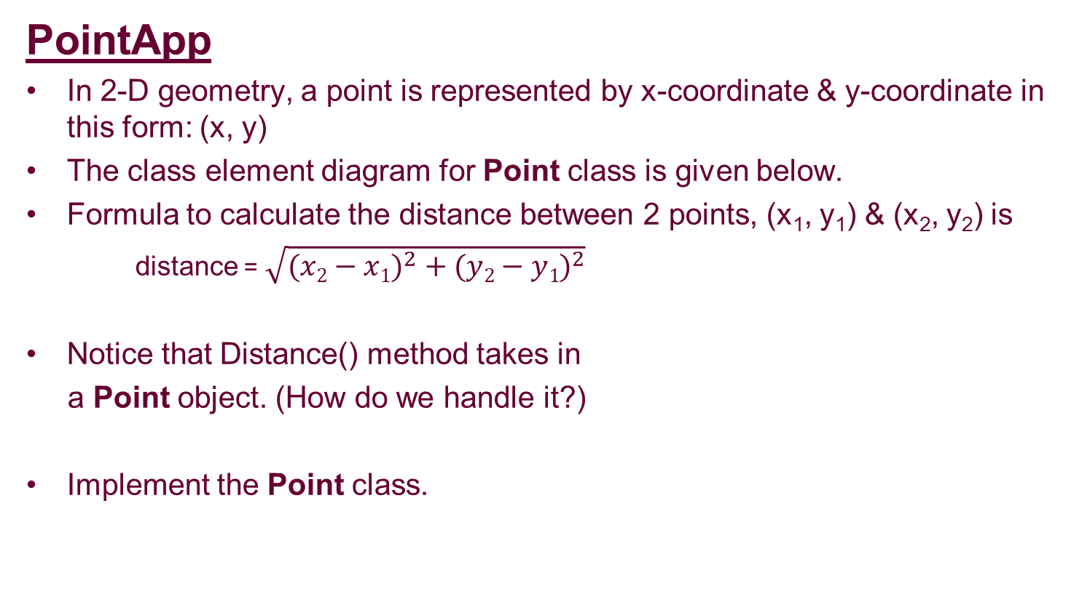
Activity _{…/2}
PointApp
In 2-D geometry, a point is represented by x-coordinate & y-coordinate in this form: (x, y)
The class element diagram for Point class is given below.
Formula to calculate the distance between 2 points, (x₁, y₁) & (x₂, y₂) is
distance = $\sqrt{{(x2−x1)}^{2} +{ (y2−y1)}^{2}}$
Notice that Distance() method takes in
a Point object. (How do we handle it?)
Implement the Point class.
Point
-x:int -y:int
+Point() +Point(int,int) +Distance(Point):double +ToString():string
Notes:
Now that you have learnt how to define a class and create instance of a class and access data and methods of the objects, let’s try this activity. Post your questions or solution in MS Teams for discussions.

Slide 24
Activity _{…/2}
PointApp
Write code in the main program (Program.cs) to do the following:
Create 2 Point objects ptA and ptB in the Main() method with the following values:
Display the distance between ptA & ptB.
variable | x | y
ptA | 2 | 2
ptB | 5 | 5

Slide 25
Summary
User-defined Class
Encapsulation
Implementing a Class
Accessing data and methods of an object
Notes:
We have come to the end of this lesson. Do post your questions in MS Teams for discussion if you have any. Thank you and good bye!

Slide 26
Appendix
Access Specifiers | Visible to objects of other classes inside the namespace collection | Visible to objects of child classes within the namespace collection | Visible to objects of other classes outside the namespace collection | Visible to objects of child classes outside the namespace collection
public | Yes | Yes | Yes | Yes
private | No | No | No | No
protected | No | Yes | No | Yes
internal | Yes | No | No | No
protected internal | Yes | Yes | No | No

